Slide 1
The Gyrophone
An Intuitive Handheld Interface for Musical Expression Utilizing Three-Dimensional Position Data to Expand the Sound Signature of Digital Samples

Slide 2
A World of Sound in the Palm of Your Hand
https://youtu.be/-QgTF8p-284

Slide 3
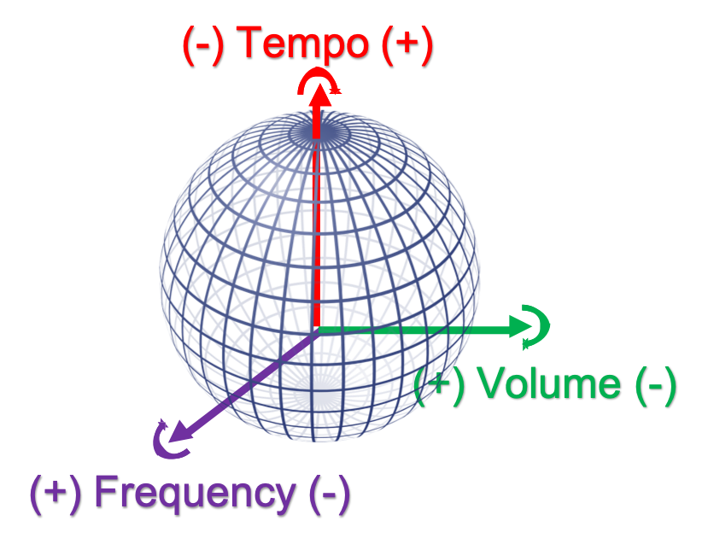
Sound Signature Characteristics
X-axis controls frequency
Y-axis controls volume
Z-axis controls tempo
Versatile applications

Slide 4
Technical Overview
MPU6050 3-axis sensor
Provides acceleration and gyroscopic input
Arduino UNO
Interfaces sensor & PC
Computer
Runs MAX
MAX Software
Processes digital input signal and correspondingly manipulates designated sound sample
Speakers
Produce sound output

Slide 5
Project Overview
Order parts
Assemble components
Develop & test Arduino code
Integrate sound output with MAX

